Slide 1

Building Question-Answering with watsonx.ai, watsonx Assistant, watsonx Discovery
Dr. Nirandika Wanigasekara AI Engineer, Client Engineering watsonx.ai
watsonx.ai
Notes:
Curated by Catherine.Cao@ibm.com

Slide 2




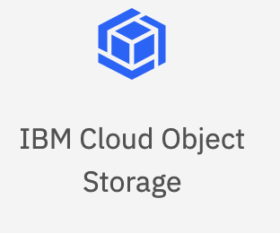

Retrieval-Augmented Generation (RAG)
Chatbot
1. Search
2. Search Query
3. Context for the Search Query
Customer’s Data Sources
6. Answer
‘Queryable’ / Searchable Repo
LLM
4. Query + Context
5. Generated Answer

Slide 3
Building Question-Answering with watsonx.ai, watsonx Assistant, watsonx Discovery
Watson Assistant
1. Search
2. Search Query
3. Context for the Search Query
Customer’s Data Sources
6. Answer
Watson Discovery
Watsonx.ai
4. Query + Context
5. Generated Answer

Slide 4
Architecture Used in the Workshop
IBM Cloud
Watson Assistant
1. Search
2. Search Query
3. Context for the Search Query
Customer’s Data Sources
6. Answer
Watson Discovery
IBM Cloud
IBM Cloud
Watsonx.ai
4. Query + Context
5. Generated Answer
Notes:
For demo purpose you can provision these instance in these places.

Slide 5
Step 0 – Indexing Content in Watson Discovery (completed by the workshop coordinator)
Watson Assistant
1. Search
2. Search Query
3. Context for the Search Query
Customer’s Data Sources
6. Answer
Watson Discovery
Watsonx.ai
4. Query + Context
5. Generated Answer
Notes:
No project was found with ID 80618725-d10b-4d7a-b91a-79c031f99eee.

Slide 6
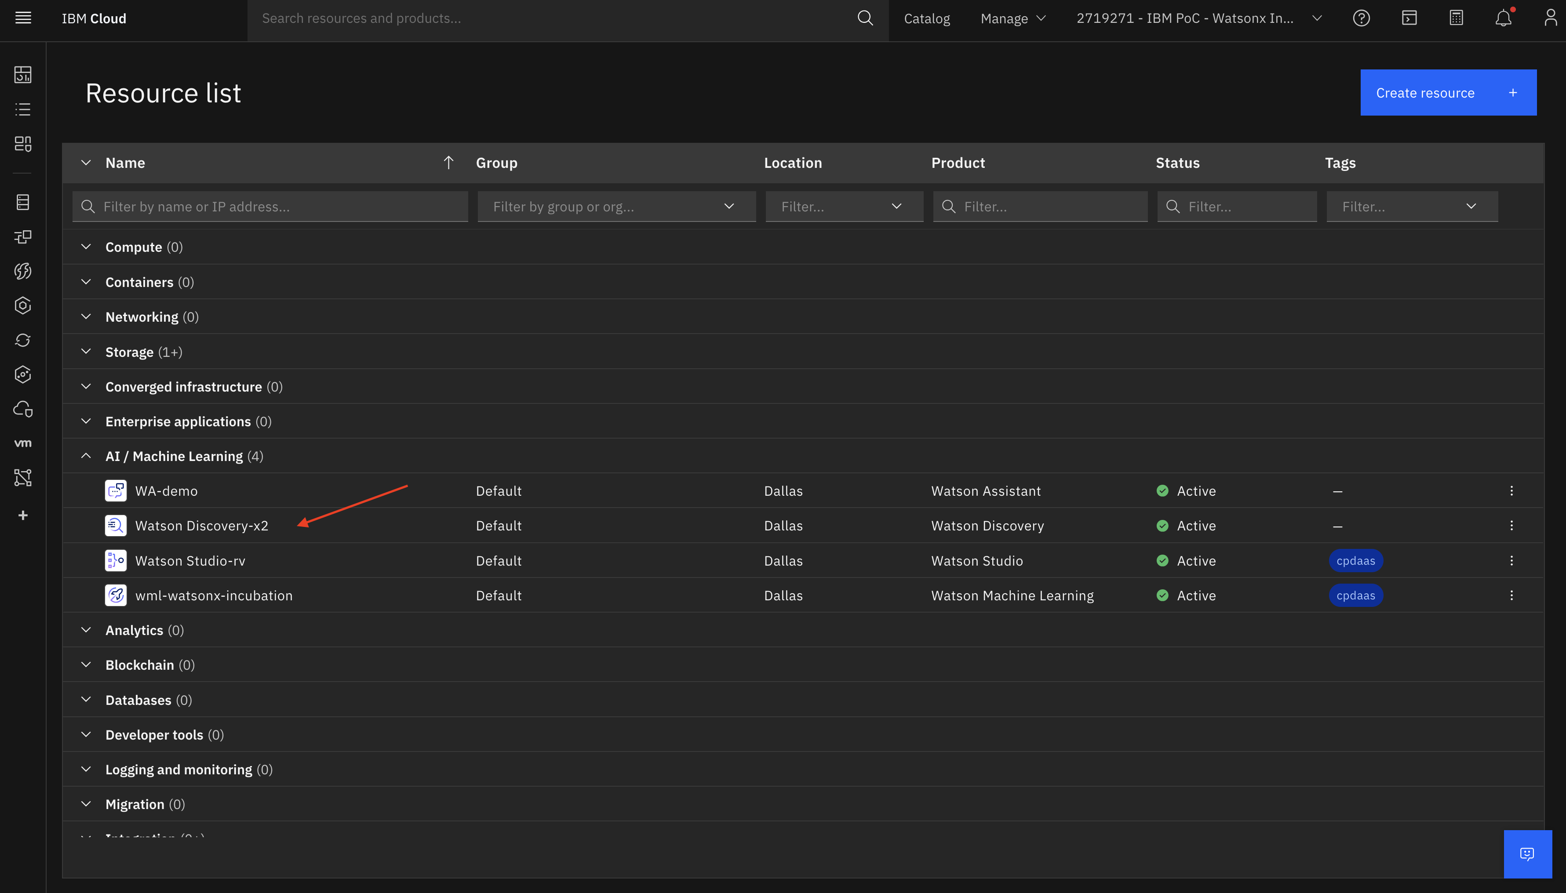
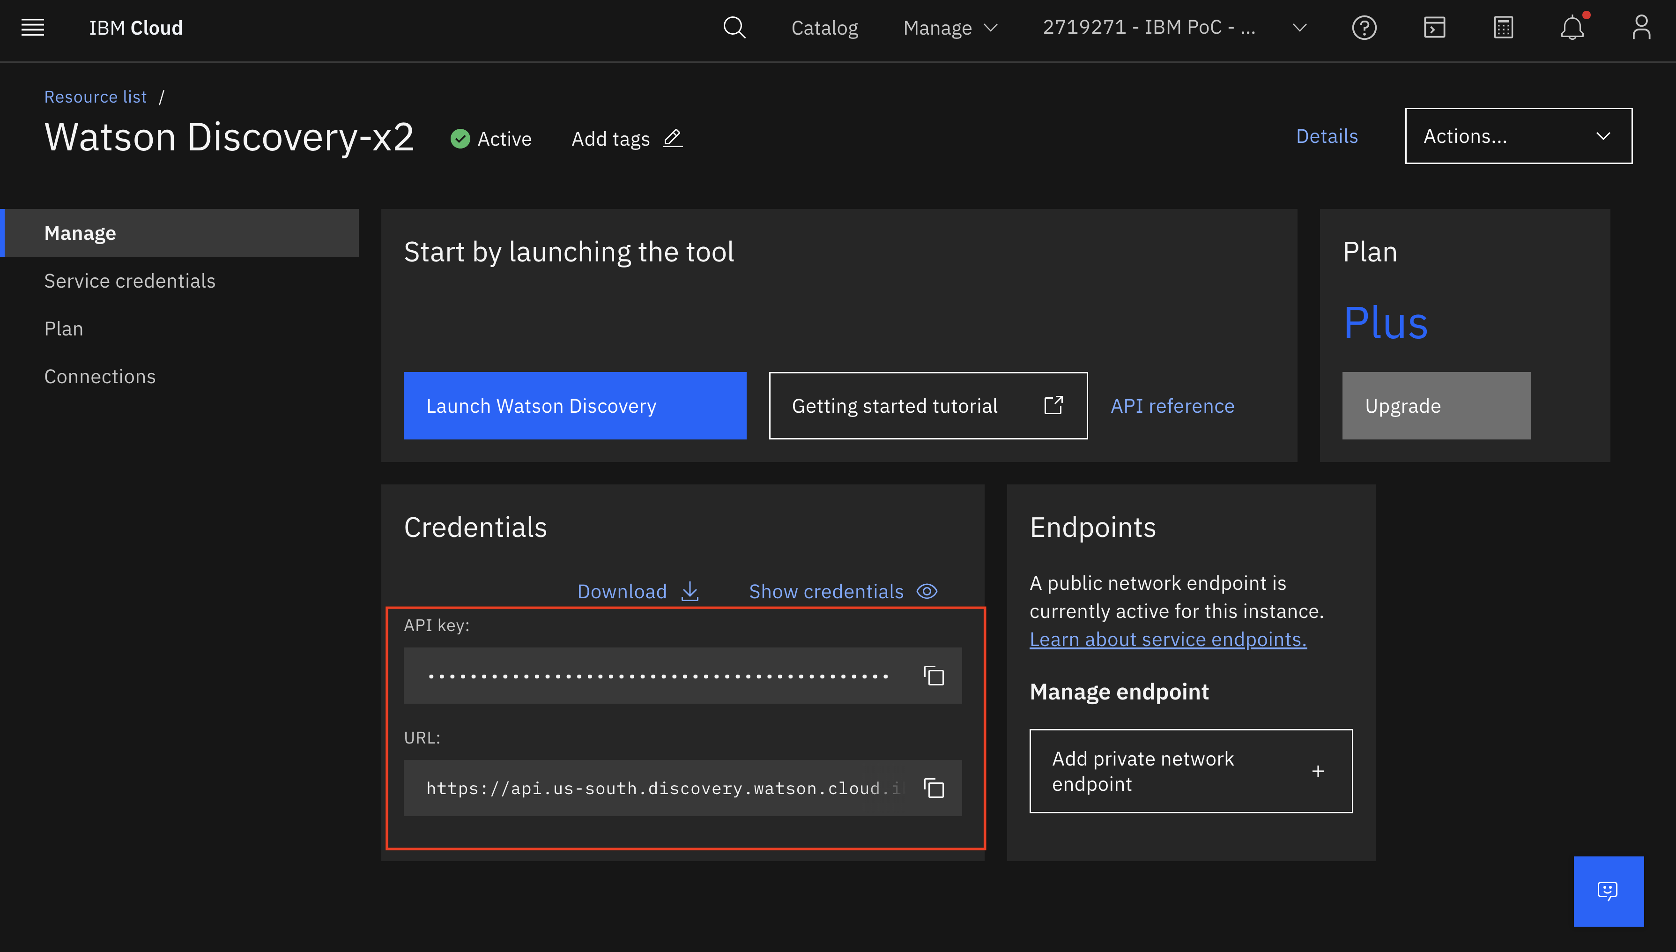
Step 1: Save the Watson Discovery URLs and API key
Login to IBM Cloud
Go to the Navigation Menu
Select Resource List
Expand AI/Machine Learning
Select your Watson Discovery Service
Go to Credentials
Copy and save the API key
Copy and save the URL

Slide 7
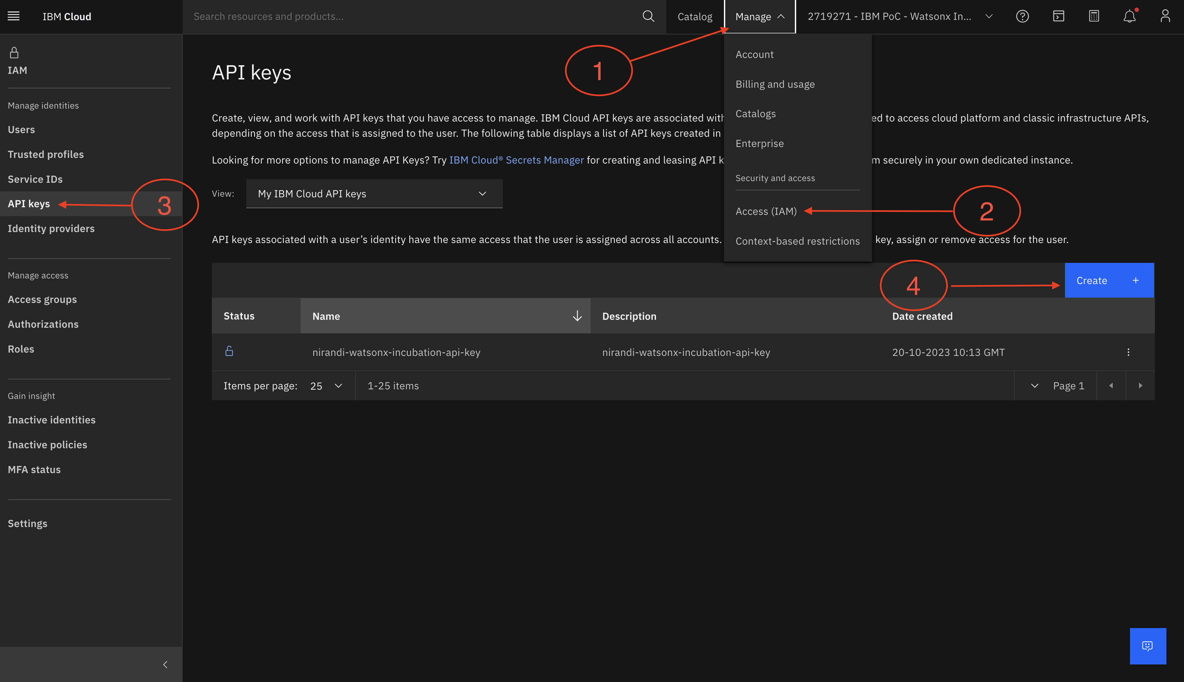
Step 2: Save the API key for IBM Cloud
Retrieve the API key you created for earlier labs and have it ready.
If you don’t have an API key follow these instructions.
Go the IBM Cloud
Manage → Access (IAM) → API keys
Enter a name and description for your API key.
Click Create.
Then, click Show to display the API key. Or, click Copy to copy and save it for later, or click Download.

Slide 8
Step 3: Add a Custom Extension for Watson Discovery
watson-discovery-query-openapi.json
Watson Assistant
1. Search
2. Search Query
3. Context for the Search Query
Customer’s Data Sources
6. Answer
Watson Discovery
Watsonx.ai
4. Query + Context
5. Generated Answer
Github link – https://github.com/knijesh/GenAI_Incubation_watsonx/tree/main/lab%207%20-%20Building%20Question-Answering%20with%20watsonx.ai%2C%20watsonx%20Assistant%2C%20watsonx%20Discovery
Notes:
No project was found with ID 80618725-d10b-4d7a-b91a-79c031f99eee.

Slide 9
Step 4: Add a Custom Extension for watsonx.ai
Watson Assistant
1. Search
2. Search Query
watsonx-openapi.json
Customer’s Data Sources
6. Answer
3. Context for the Search Query
Watson Discovery
Watsonx.ai
4. Query + Context
5. Generated Answer
Github link – https://github.com/knijesh/GenAI_Incubation_watsonx/tree/main/lab%207%20-%20Building%20Question-Answering%20with%20watsonx.ai%2C%20watsonx%20Assistant%2C%20watsonx%20Discovery
Notes:
No project was found with ID 80618725-d10b-4d7a-b91a-79c031f99eee.

Slide 10
Step 5– Upload Actions Flows
discovery-watsonx-actions.json
Search
Generate Answer
Invoke watsonx
generation API
Watson Assistant
1. Search
2. Search Query
3. Context for the Search Query
Customer’s Data Sources
6. Answer
Watson Discovery
Watsonx.ai
4. Query + Context
5. Generated Answer
Github link – https://github.com/knijesh/GenAI_Incubation_watsonx/tree/main/lab%207%20-%20Building%20Question-Answering%20with%20watsonx.ai%2C%20watsonx%20Assistant%2C%20watsonx%20Discovery
Notes:
No project was found with ID 80618725-d10b-4d7a-b91a-79c031f99eee.

Slide 11
Step 6–Update the Variables (MUST)
watsonx_project_id
discovery_project_id
Watson Assistant
1. Search
2. Search Query
3. Context for the Search Query
Customer’s Data Sources
6. Answer
Watson Discovery
Watsonx.ai
4. Query + Context
5. Generated Answer
Github link – https://github.com/knijesh/GenAI_Incubation_watsonx/tree/main/lab%207%20-%20Building%20Question-Answering%20with%20watsonx.ai%2C%20watsonx%20Assistant%2C%20watsonx%20Discovery

Slide 12

RAG Pattern Implemented! Hooray!!

Slide 13
Optional : Variables to Tweak – Wationx.ai Related
model_id
model_input
model_parameters_temperature
model_parameters_repetition_penalty
model_parameters_max_new_tokens
model_parameters_min_new_tokens
Watson Assistant
1. Search
2. Search Query
3. Context for the Search Query
Customer’s Data Sources
6. Answer
Watson Discovery
Watsonx.ai
4. Query + Context
5. Generated Answer
Github link – https://github.com/knijesh/GenAI_Incubation_watsonx/tree/main/lab%207%20-%20Building%20Question-Answering%20with%20watsonx.ai%2C%20watsonx%20Assistant%2C%20watsonx%20Discovery

Slide 14
Optional : Variables to Tweak – Wationx Discovery Related
query_text
Watson Assistant
1. Search
2. Search Query
3. Context for the Search Query
Customer’s Data Sources
6. Answer
Watson Discovery
Watsonx.ai
4. Query + Context
5. Generated Answer
Github link – https://github.com/knijesh/GenAI_Incubation_watsonx/tree/main/lab%207%20-%20Building%20Question-Answering%20with%20watsonx.ai%2C%20watsonx%20Assistant%2C%20watsonx%20Discovery

Slide 15
Optional: Useful Debugging Variables
model_response
passages
snippet
Watson Assistant
1. Search
2. Search Query
3. Context for the Search Query
Customer’s Data Sources
6. Answer
Watson Discovery
Watsonx.ai
4. Query + Context
5. Generated Answer
Github link – https://github.com/knijesh/GenAI_Incubation_watsonx/tree/main/lab%207%20-%20Building%20Question-Answering%20with%20watsonx.ai%2C%20watsonx%20Assistant%2C%20watsonx%20Discovery

Slide 16
Any Questions?
Enjoy Building Your own Agent Assistant based on the Retrieval-Augmented Generation (RAG) Pattern!

